Slide 1

Door Status Monitor with Telegram Notifications
Semester II (2021-2022)
Embedded Systems Course
Final Project Presentation
Course Code: CPE316
Supervisors: Dr. Iman Elawady ; ENG. Michael B.Khani
Team !404 members:
Berkay tunç 1810213029 | AMER ALYASIN 2017710213014
Mahamat Haroun Djouma 1910213544 | Sinan Can CENGİZ 2010213552
Mahamout Ouchar Cherif 1810213023 | Serhan çetinkaya 1810213097
Abdallah Alsayyed Ahmad 1810213532 | Atacan Özbay 1810213032

Slide 2

CONTENTS
Introduction
Summary
Goals
Related Works
Application
Objectives
Project Design
Hardware
Software
Conclusion
Challenges
Results
Future works
References

Slide 3
INTRODUCTION

Slide 4
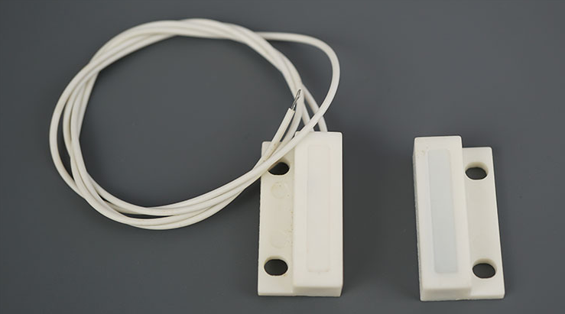

Slide 5
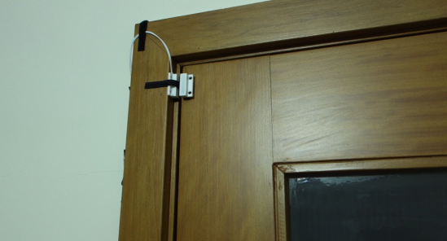
INTRODUCTION
Summary
In this project, we’ll create a Telegram Bot that will send messages to your Telegram account whenever a door changes state. To detect the change, we’ll use a magnetic contact switch.
A magnetic contact switch is basically a reed switch encased in a plastic shell so that you can easily apply it to a door, a window, or a drawer to detect if it is open or closed.

Slide 6
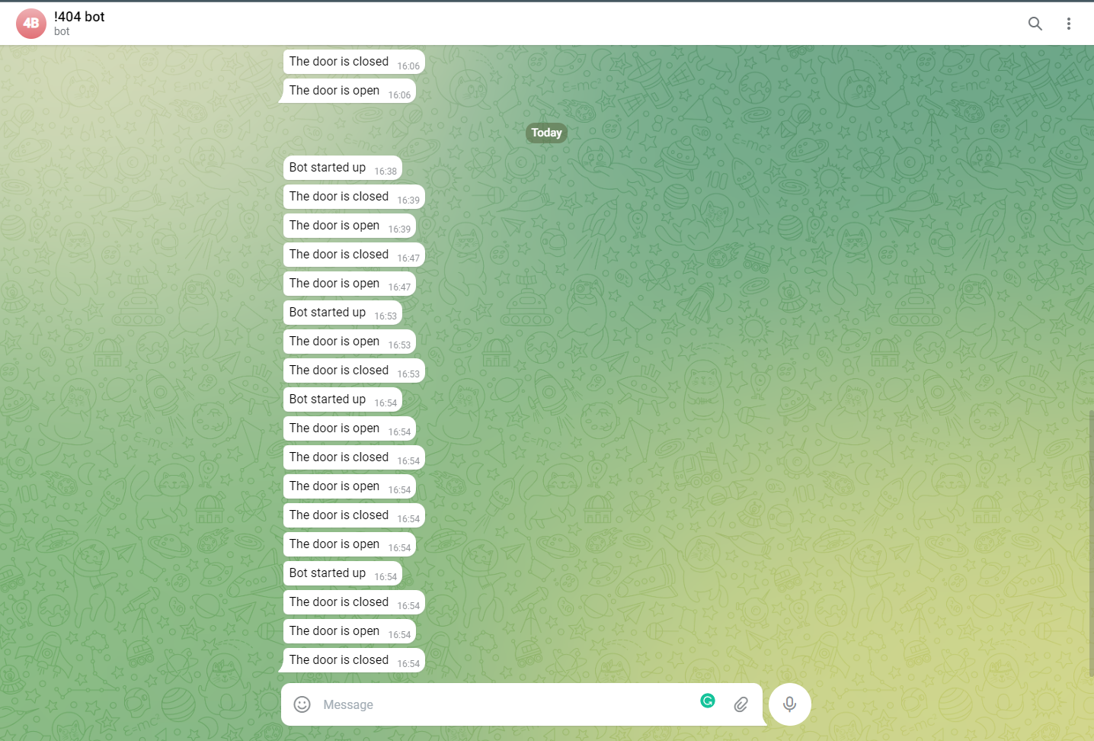

Slide 7

INTRODUCTION
Goals
Being notified whenever our home door, window or even our locker is opened
Receive the signal in a fraction of seconds
Avoid data leakage, the signal and the data are kept with the user
Reduce the rate of theft

Slide 8
RELATED WORKS

Slide 9
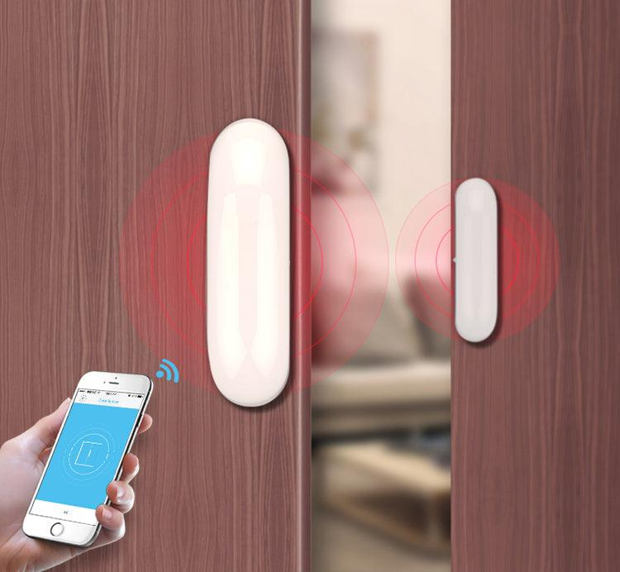
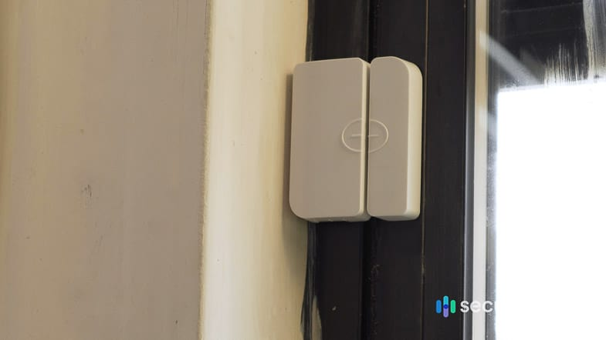
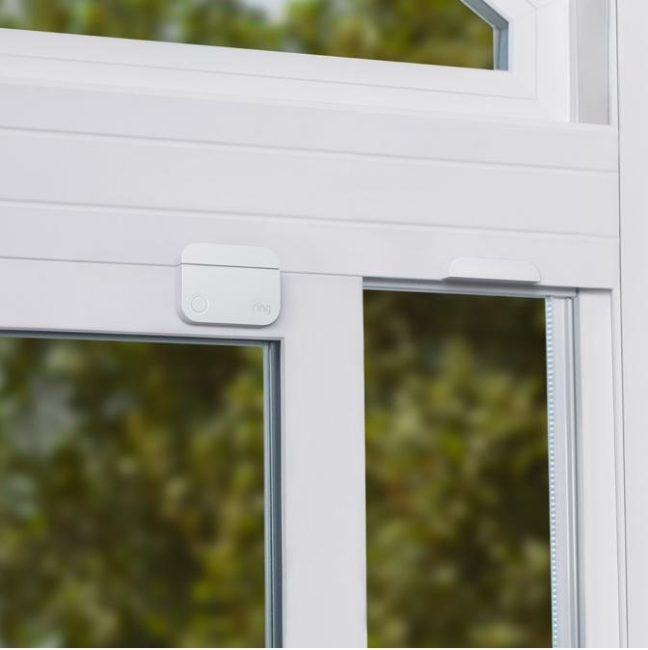
RELATED WORKS
It exist in the market a variety of other sensor model

Slide 10
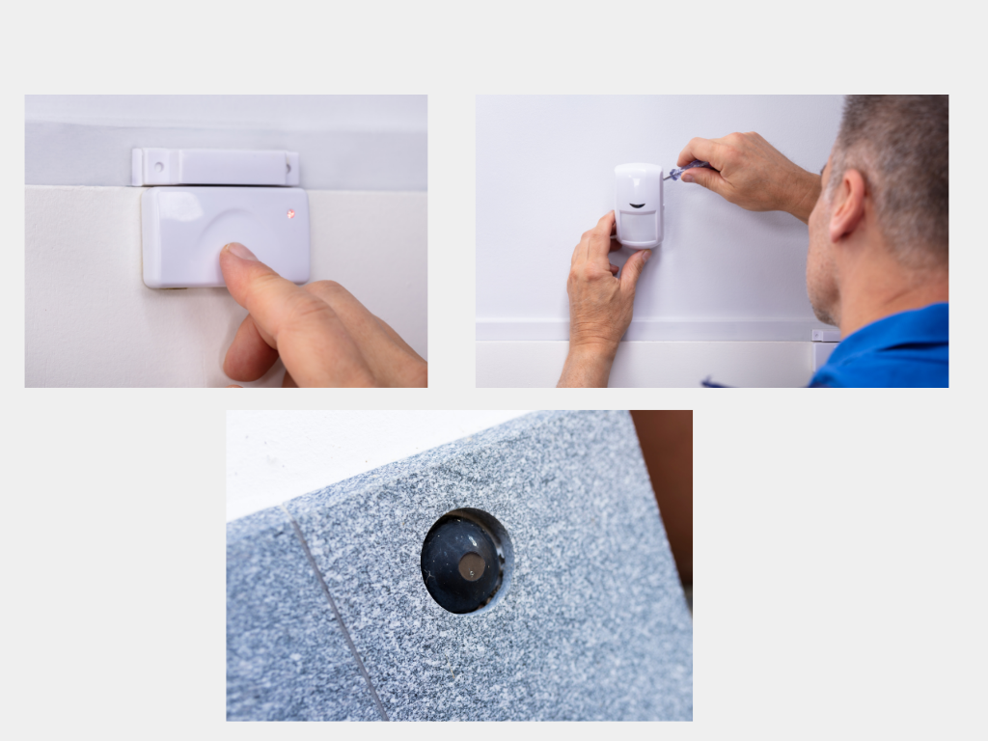
RELATED WORKS
Notes:
sinan son

Slide 11
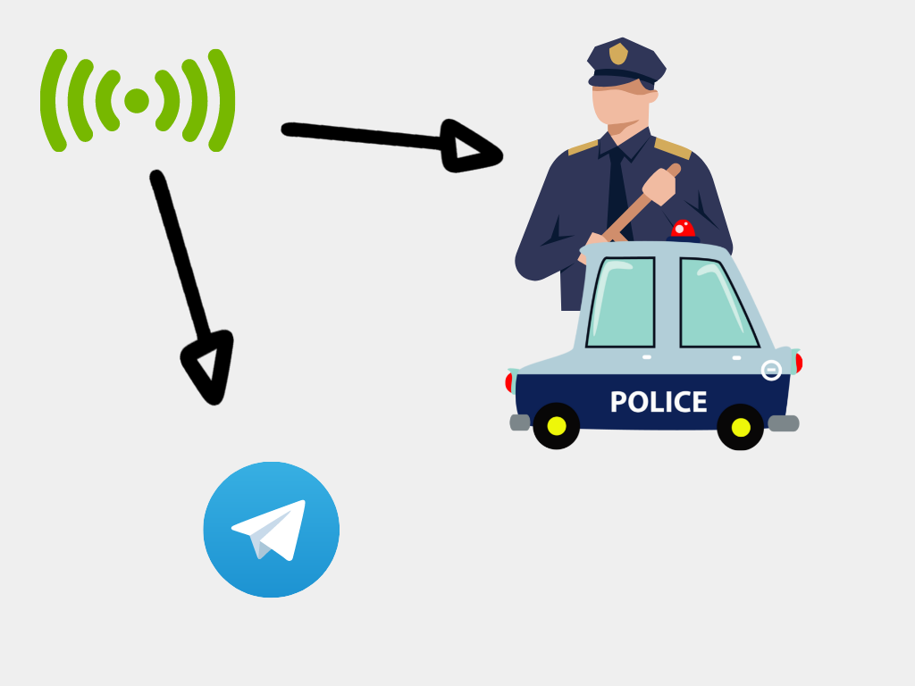

Future Improvement
In the future we may add a life battery to our chip
Design the product towards commerces and offices door
Send a notification to the police directly
Notes:
mahmut

Slide 12
PROJECT DESIGN

Slide 13
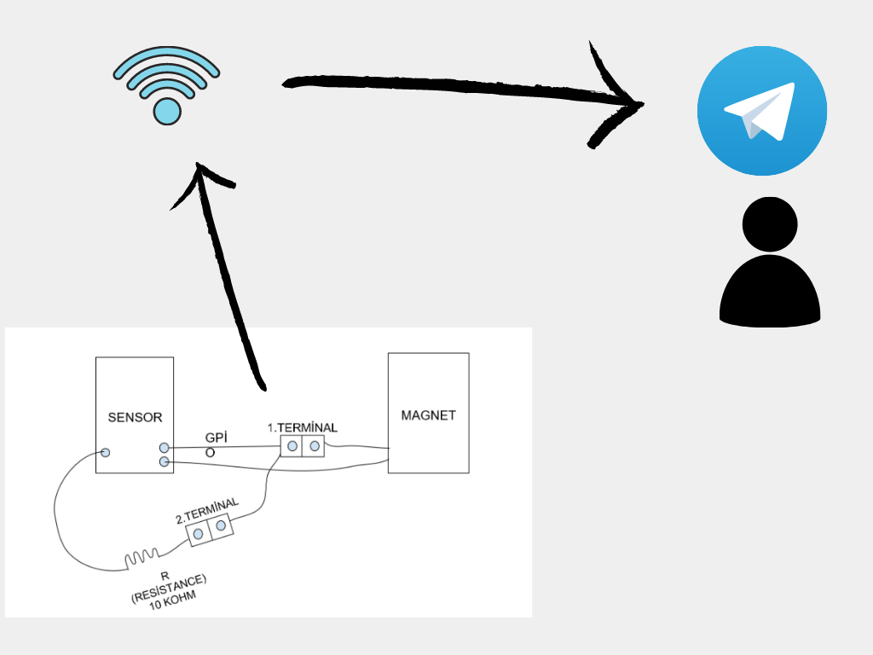
PROJECT DESIGN
Materials used :
ESP32
1× Magnetic Reed Switch
1× 10kΩ resistor
1 power bank
1 usb cable
Jumper wire

Slide 14
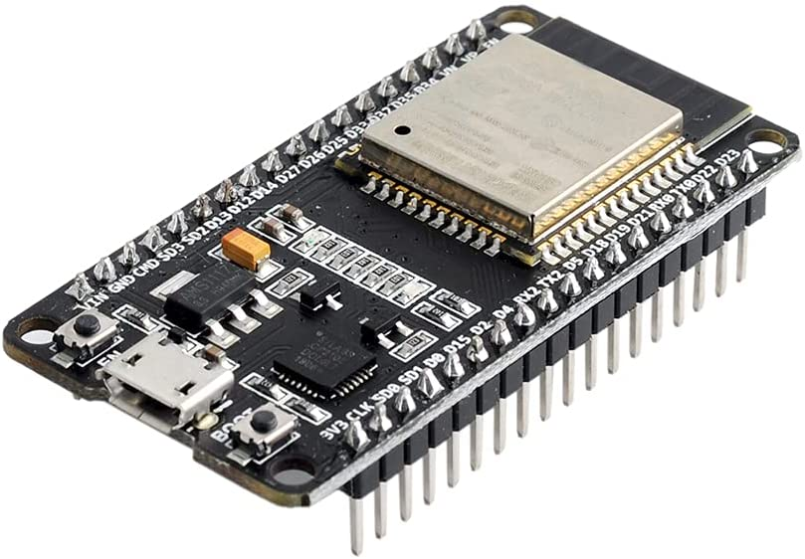
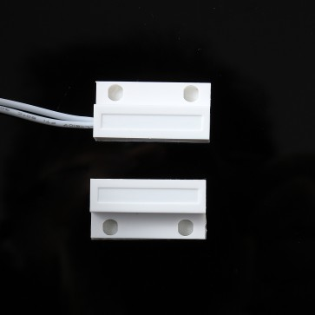
Esp32 doit devkit
Magnetic reed switch
The esp32 is connected to the contact switch with a jumper
used to detect whenever there is contact

Slide 15
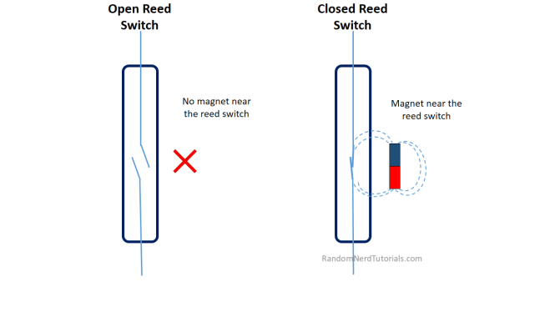
How the magnetic switch works ?

Slide 16
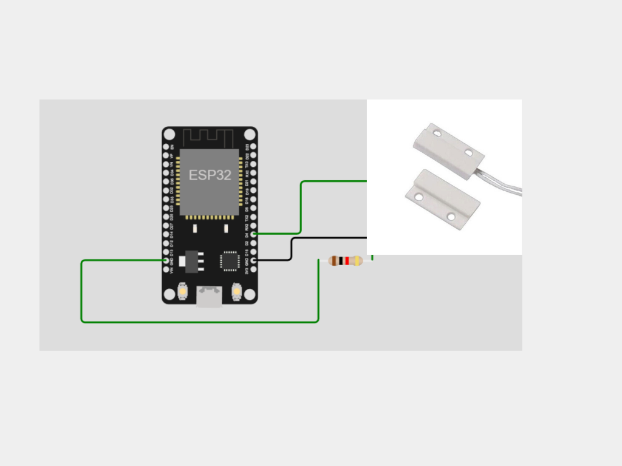
PROJECT DESIGN
Connected to 3v3 GND2 and D4

Slide 17
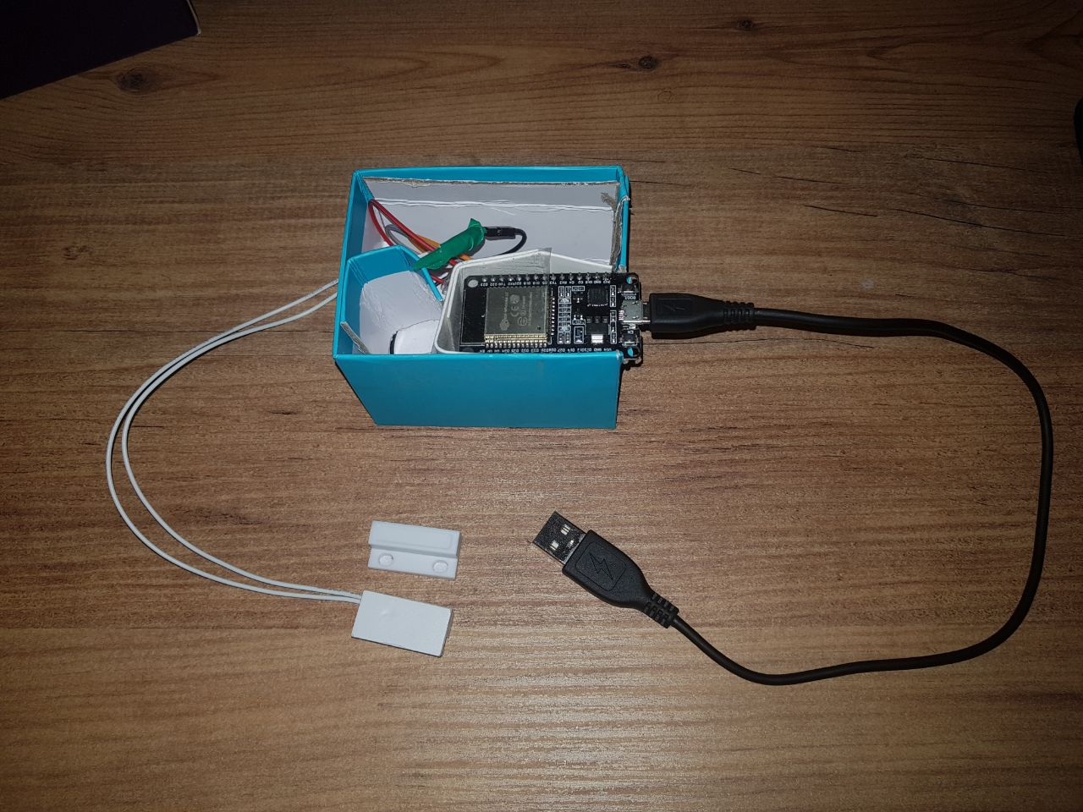
Final design picture

Slide 18

Telegram bot
Notes:
devre sunumu

Slide 19
PROJECT DESIGN
Hardware constraint :
No reliable alimentation
Chip less efficient and its size is too big
Need to troubleshoot every time the code is modified
Software constraint :
Need to load the code to the chip every time we need to change the internet connection
Chip disconnect itself every 2 hours

Slide 20
CONCLUSION

Slide 21



But Our has 1 extra improvement that changes everything :
Since we are using a telegram bot, data of the user secure is and can not leak
Notes:
abdullah

Slide 22

CONCLUSION
The product is still in prototype version it still has a lot improve but has an enormous potential
In the future we may add a efficient power supply, reduce the chip size and enable the functionality of sending notification to the police

Slide 23
References
https://randomnerdtutorials.com/
wowki.com
wikipedia.com
Youtube.com

